Slide 1
Gamified Learning Platform for Rural Education
SIH25048
Review-1
Batch Number: CSE_158
Under the Supervision of,
Dr. Vijaya Kumar A
School of Computer Science and Engineering
Presidency University
Roll Number | Student Name
20221CSE0335 20221CSE0362 20221CSE0097 | Rakshitha V Varshini P D Lohith K B
Name of the Program: Computer Science and Engineering
Name of the HoD: Dr.Asif Mohammed, Dr.Blessed Prince
Name of the Program Project Coordinator: Dr.Jayavadivel Ravi , Mr.Muthuraju V
Name of the School Project Coordinators: Dr. Sampath A K , Dr. Geetha A

Slide 2
Contents:
Problem Statement
Objectives
Background and Related work for title Selection
Analysis of Problem Statement
Innovation or Novel Contributions
Git - hub Link
Timeline of the Project
References

Slide 3
Problem Statement :
Rural students often lack access to quality education due to limited teachers, resources, and engaging learning tools. Traditional teaching methods fail to keep students interested, leading to poor learning outcomes and high dropout rates. Existing digital learning platforms are mostly designed for urban users and are not suitable for rural conditions. There is a need for an easy-to-use and engaging learning system for rural students. A gamified learning platform can improve motivation, participation, and knowledge retention. This project aims to provide an interactive and accessible digital education solution for rural learners.

Slide 4
Objectives:
To develop a user-friendly digital learning platform for rural students.
To make learning engaging through gamification elements like points, badges, and levels.
To improve student motivation and participation in the learning process.
To provide easy access to quality educational content in rural areas.
To track student performance and learning progress digitally.
To enhance overall learning outcomes and reduce dropout rates among
rural students.

Slide 5
Background and Related Work for Title Selection:
Rural students have limited access to quality teachers and learning resources.
Traditional teaching methods are less engaging and reduce student interest.
Many e-learning platforms exist but are mainly designed for urban users.
Gamification techniques like points, badges, and quizzes improve learning motivation.
Research shows game-based learning increases knowledge retention.
Very few platforms focus on combining gamification with rural education needs.
Hence, the title “Gamified Learning Platform for Rural Education” was selected.

Slide 6
Analysis of Problem Statement:
A large gap exists between rural and urban education quality.
Students in rural areas have fewer opportunities for interactive learning.
Low interest in studies leads to poor academic performance.
Learning systems available today do not adapt to individual student progress.
Teachers find it difficult to monitor and guide students digitally.
There is a need for a system that encourages continuous learning through activities.
A gamified platform can provide structured, engaging, and personalized learning support.

Slide 7
Innovation or Novel Contributions:
Uses game-based learning instead of traditional online classes.
Provides reward-based education to motivate rural students.
Includes progress tracking and performance analytics.
Designed for low-bandwidth and rural usability.
Supports interactive quizzes, challenges, and leaderboards

Slide 8
Github Link
Git hub Link:
https://github.com/Raksh-itha-v/raksh

Slide 9
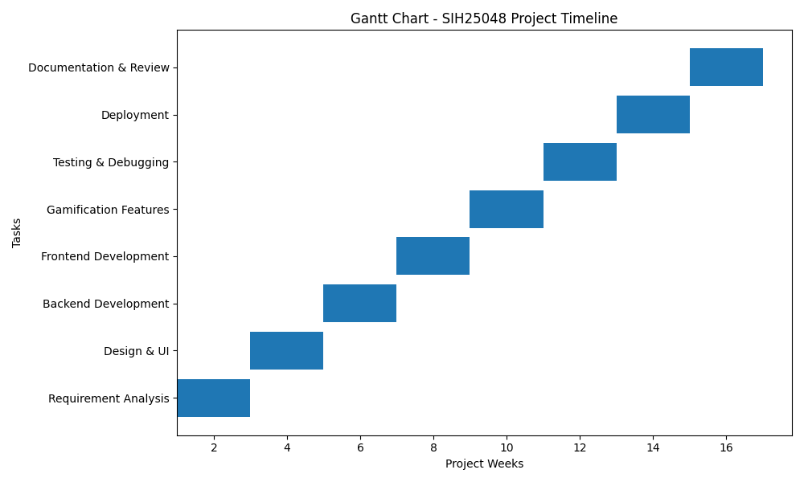
Timeline of the Project (Gantt Chart)

Slide 10
References (IEEE Paper format)
X. You and M. Sanmugam, “Literature Analysis on the Impact of Gamified Education on Engagement, Motivation, and Learning Outcomes Among Preschool Children in Rural Communities in China,” JENTIK: Jurnal Pendidikan Teknologi Informasi dan Komunikasi, vol. 3, no. 2, pp. 68–79, 2024.
“Gamification in Online Learning: A Systematic Review of Engagement and Learning Outcomes in Digital Education,” ResearchGate, Dec. 2025.
S. Hebbar, “Examining Gamification’s Impact on Perceived Satisfaction in E-Learning,” Interactive Learning Environments, 2025.
R. Soni, D. V. Abhonkar, N. Dhiman, and N. Gupta, “Impact of Digital Learning Platforms on Student Performance in Rural Areas,” Int. J. Contemp. Res. Multidiscip., vol. 4, no. 4, pp. 414–423, 2025.
S. Triantafyllou, “Gamification in Education and Training: A Literature Review,” Int. J. Educ. Res., 2025.

Slide 11


